Slide 1
The SQL Server 2019 Workshop https://aka.ms/sqlworkshops
Microsoft Azure Data SQL Server Engineering

Slide 2
SQL Server 2019 Workshop Modules
01 Introduction to SQL Server 2019
02 Intelligent Performance
03 Security
04 Availability
05 Modern Development Platform
06 Linux and Containers
07 SQL Server on Kubernetes
08 Data Virtualization
09 Big Data Clusters
10 Additional Capabilities, Migration, and Next Steps

Slide 3
Module 01 Introduction to SQL Server 2019
Notes:
TODO: Would be nice to have icon here

Slide 4
Businesses face broad challenges if they do not modernize
Expensive ETL for integrating external data sources
Siloed relational and big data
Time-consuming query performance tuning
Meeting data security and compliance standards
Keeping data and applications always available.
Performance affected by unreliable I/O latency
Consistency across platforms and languages
Should I invest in containers
Barriers to creating intelligent apps with AI and ML

Slide 5
It’s built on a strong foundation
Major capabilities of SQL Server 2016 and 2017
Intelligent performance
Query Store
Adaptive Query Processing
Automatic Tuning
Columnstore and In-Memory OLTP
“It Just Runs Faster”
Layers of security
Always Encrypted
Row Level Security
Dynamic Data Masking
Mission critical availability
Clusterless Availability Groups
Distributed Transactions for Availability Groups
Resumable Index Maintenance
Developer experience
JSON
Temporal Tables
Graph Database
Modern platform
Linux and Containers
Machine Learning Services with R and Python

Slide 6


SQL Server 2019
Industry-leading performance and security, with intelligence over all your data
Intelligence over any data
Choice of platform, language and container
Industry-leading performance and availability
Most secure over the last 9 years⁶
Insights in minutes on any device
+
#1 OLTP performance¹
#1 DW performance on 1TB², 3TB³,10TB⁴, and 30TB⁵
Intelligent Database
PHP
Node.js
C#/VB.NET
AI and Machine Learning over all data with the power of SQL and Spark
T-SQL
Java
C/C++
Python
Ruby
The best of Power BI and SQL Server Reporting Services with Power BI Report Server
In-memory across all workloads
Most consistent data platform
Edge
Private cloud
Public cloud
1/10th the cost of Oracle
All TPC Claims as 11/3/2019.
¹ http://www.tpc.org/4081; ² http://www.tpc.org/3331; ³ http://www.tpc.org/3336 ⁴ http://www.tpc.org/3337 ⁵ http://www.tpc.org/3345 ; ⁶ National Institute of Standards and Technology Comprehensive Vulnerability Database

Slide 7











SQL Server 2019 solves modern data challenges
Data virtualization and Big Data Clusters
Modern platforms with compatibility
Built-in Machine Learning and extensibility
R
PolyBase
SQL
ARM64
Microsoft SQL Server
Intelligent performance
Layers of security and compliance
Business critical high availability
Query
ciphertext
Secure Enclaves
Learn
Memory grant
In-memory
Data Classification
plaintext
Run query
Intelligent Query Processing
Accelerated Database Recovery

Slide 8
SQL Server 2019 solves modern data challenges
Data virtualization and Big Data Clusters
Modern platforms with compatibility
Built-in Machine Learning and extensibility
R
PolyBase
SQL
ARM64
Microsoft SQL Server
Intelligent performance
Layers of security and compliance
Business critical high availability
Query
ciphertext
Secure Enclaves
Learn
Memory grant
In-memory
Data Classification
plaintext
Run query
Intelligent Query Processing
Accelerated Database Recovery

Slide 9
Module 02 Intelligent Performance

Slide 10

Industry leading performance
Intelligent Database
Challenge
DBA’s spend most of their time tuning database performance, leading to high operational costs
Solution
Automation with Intelligent Database capabilities while providing mission critical performance
Gain performance with no app changes with Intelligent Query Processing
Performance insights anytime anywhere with Query Store and lightweight query profiling
Accelerate I/O performance with Persistent Memory
Performance
Improves performance with no app change
App
Persistent Memory
Query Store
Intelligent Query Processing improved Banco Itau’s query performance by 92% without the need for any code changes
Intelligent performance

Slide 11
Gain performance without changing the application
The Intelligent Query Processing feature family
Intelligent QP
Adaptive QP
Table Variable Deferred Compilation
Batch Mode for Row Store
Approximate QP
Scalar UDF inlining
Intelligent Query Processing
Sequential Key Insert Performance
In-Memory technologies
Hybrid Buffer Pool
Persistent Memory Support
Memory-Optimized TempDB Metadata
Adaptive Joins
Interleaved Execution
Memory Grant Feedback
Approximate Count Distinct
Batch Mode
Batch Mode
Row Mode
Intelligent performance
Bold indicates new and improved features in SQL Server 2019

Slide 12
Intelligent Query Processing
dbcompat to enable
140 | SQL Server 2017
150 | SQL Server 2019
The problem
Build a query processor to work and adapt to any type of workload with no application changes required
The Solution(s)
Build intelligent, adaptable operators
Modify query plans in cache based on previous execution
Expand batch mode
Execution data drives downstream compilation
Smarter query processing
Feature Suite
Adaptive Join
140
140
150
Memory Grant Feedback for Batch and Row
Batch Mode for Row Store
150
Interleaved Execution
Table Variable Deferred Compilation
140
150
Approximate Count Distinct
Scalar UDF Inling
150
Notes:
2 mins

Slide 13
Tempdb Just Runs Faster
The problem(s)
High multi-user rates of tempdb usage can lead to latency due to….
allocation page latch waits – Multiple users needing to allocate pages for temp tables
system table page latch waits – High rates of create/drop require system table modifications
The Solution
Create multiple files to partition allocation pages
SQL Server 2016+ creates multiple tempdb files during setup
Start with 8 and add by 4 until concurrency alleviated
But…what about system tables?
The SQL 2019 Solution
Key tempdb system tables become SCHEMA_ONLY memory optimized tables
Latch and lock free
Turn on with ALTER SERVER CONFIGURATION
This is NOT user data just metadata so memory requirements small

Slide 14
Module 02 Activity: Intelligent Performance

Slide 15
Module 03 Security

Slide 16

SQL Server confidential computing
Always Encrypted with secure enclaves
Always Encrypted with secure enclaves
Data Classification and auditing built-in
TDE scan suspend and resume
Simplified certificate management
plaintext
ciphertext
Enhanced client driver
Enclave
plaintext
With Secure Enclaves, Hiscox Insurance can now enforce highly restricted client access without inhibiting real-world data analysis
Layers of security
Notes:
Whole quote: “Hiscox is a respected international insurance group. Our customers trust us to protect not only their property but also their private information.
With the Secure Enclaves enhancement of Always Encrypted in SQL Server 2019 we can now enforce highly restricted client application based access to our customers’ most sensitive data without inhibiting our real world data handling and analysis requirements.”

Slide 17
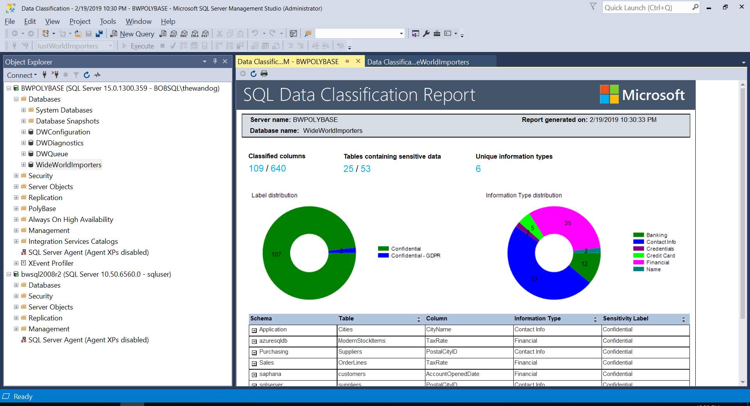
Data Classification and Auditing
The problem
I need to classify my data in SQL Server and audit access to the classified data
SQL Server 2017
SQL Server 2019 and Azure SQL Database
ADD SENSITIVITY CLASSIFICATION TO
dbo.sales.price, dbo.sales.discount
WITH ( LABEL='Highly Confidential', INFORMATION_TYPE='Financial' )
SQL Server 2019
SQL Server Auditing
data_sensitivity_information
Who, what, and when accessed my classified data?

Slide 18
Module 03 Activity: Data Classification

Slide 19
Module 03 High Availability

Slide 20
SQL Server is always available
The New Recovery Process with ADR
Oldest uncommitted Tx (XACT_BEGIN_LSN)
Last checkpoint (or oldest dirty page LSN)
End of log
Challenge
Log Grows out of Control
Long rollback blocks applications
Long Recovery prolongs downtime
Index operations resource intensive
Solution
Accelerated Database Recovery (ADR)
Online Index enhancements
Availability group enhancements
Phase 1: Analysis
Phase 2: Redo from sLog
Phase 2: Redo
Phase 3: Undo from sLog
sLog is persisted to disk as part of checkpoint
Only this portion of the Transaction Log is scanned.
Transaction Log
Start of log
sLog
Log records for non-versioned ops are copied to sLog
Bank achieves high availability of mission critical data thanks to Accelerated Database Recovery
Mission critical high availability
Notes:
Space out the Challenge and Solution sections better

Slide 21


Accelerated Database Recovery (ADR)
Read the paper
How it works
Enable/disable as a database option
Uses a Persisted Version Store (PVS)
Independent of locking and isolation levels
Rollback faster than you can react
Undo recovery faster than you can look it up
Transaction log truncation not tied to active transactions
Key questions
Does it require more space?
Will it affect performance?
Will I still see versions in tempdb?
How does it work with Always On Availability Groups?
Accelerated Database Recovery powers Azure SQL Database Hyperscale
Mission critical high availability
Notes:
Format and separate the two sections

Slide 22
Module 04 Activity: Accelerated Database Recovery

Slide 23

Module 05 The Modern Development Platform

Slide 24

Enhance the developer experience
Machine Learning and T-SQL Extensibility
T-SQL requires access rights for security
Satellite process runs in isolation
SQL Graph enhancements
UTF-8 support
Machine Learning Services enhancements
SQL Server Language Extensions and the Extensibility Framework
Security, isolation, and governance built-in
T-SQL
Direct communications for performance
Launch pad
Resource governor controls CPU, memory and process affinity
Data science company can mine graph data and carry out machine learning at scale for cancer research
Developer experience
Notes:
Whole quote:
“With SQL Server 2019 big data clusters, we can solve for on-demand big data experiments. We can analyze cancer research data coming from dozens of different data sources, mine interesting graph features and carry out analysis at scale. With the big data cluster feature in SQL Server, we have been able to eliminate non-trivial challenges and are able to move our data onto cloud servers to use high quality compute resources for the length of a study and not be restricted by performance constraints.”
Pieter Derdeyn, Knowledge Engineer, Systems Imagination

Slide 25
Module 05 Activity: Extending T-SQL with Java

Slide 26
Module 06 SQL Server 2019 on Linux and Containers

Slide 27



Platform of choice with compatibility
Windows
Linux
New capabilities for Linux
Replication
Change Data Capture
Distributed transactions
Machine Learning
Polybase
Tempdb files auto-config
Containers
Microsoft Container Registry
Red Hat Images
Non-root Containers
Containers and Kubernetes
Fintech company swiftly migrated workloads to SQL Server on Linux with minimal downtime and no performance issues
Modern platform

Slide 28

Why SQL Server Containers?
Portable
Run anywhere containers are supported
Lightweight
Reduced disk, CPU, and memory footprint
Consistent
Consistent image of SQL Server, scripts, and tools
Efficient
Faster deployment, reduced patching, and less downtime
Container configuration
Persisted storage
Database
Switch for
simple updates
Container
Container
Container
sqlservr
sqlservr
sqlservr
Container Runtime
Bins/libs
Bins/libs
Bins/libs
Host OS
Infrastructure
Notes:
The right diagram is to show how to update SQL Server by “switching” containers

Slide 29

Linux and Windows Containers Explained
Linux Image on Linux host
Linux Native Process
Linux Image on Windows host
Run in a Linux Virtual Machine
LCOW – Virtualized process
WSL2 – Virtualized process
Windows image on a Windows host
Process Isolation - Native Windows Process
Hyper-V Isolation – Virtualized Process
Windows image on Linux host

Slide 30
The new update for SQL Server
SQL Server 2017 CU8 Container
volume
rollback
SQL Server 2017 Latest Container
update
SQL Server
databases
SQL Server 2019
upgrade

Slide 31
Building your own image
Then RESTORE the backup after you start the container
Try it yourself with Replication
FROM mcr.microsoft.com/mssql/server:2017-latest
COPY ./yourbackup.bak /var/opt/mssql/data/yourbackup.bak
CMD ["/opt/mssql/bin/sqlservr"]
ddl.sql
CREATE DATABASE mydb
GO
CREATE TABLE mytable (….
GO
….
The “Vin Yu” method
FROM mcr.microsoft.com/mssql/server:2017-latest
COPY . /
RUN chmod +x /db-init.sh
CMD /bin/bash ./entrypoint.sh
db-init.sh
sleep 15s
/opt/mssql-tools/bin/sqlcmd –iddl.sql
entrypoint.sh
/db-init.sh & /opt/mssql/bin/sqlservr
See here how to add other packages

Slide 32
Module 06 Activity: Linux and Containers

Slide 33
Module 07 SQL Server on Kubernetes

Slide 34




The What and Why of k8s?
Read the origins
You want the power of containers at scale
Consistency, portability, lightweight, maximum uptime, faster patching
What is Kubernetes?
“system for automating deployment, scaling, and management of containerized applications”
Production-grade container orchestration
Scheduling, resource management, high-availability, networking, storage
Why Kubernetes?
Open-sourced consistent platform of software services
Industry and production proven

Slide 35







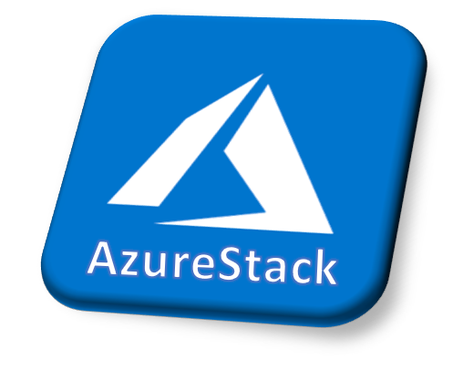

The Kubernetes Players
Cloud Providers
Azure Kubernetes Service (AKS)
Amazon Elastic Kubernetes Service (EKS)
Google Kubernetes Engine (GKE)
Red Hat OpenShift Online
Microsoft Azure Red Hat OpenShift
Managed Providers on your hardware
Red Hat OpenShift
Pivotal Container Service (PKS)
Azure Stack (AKS Engine)
Rancher
Open Source k8s
kubeadm
Minikube

Slide 36
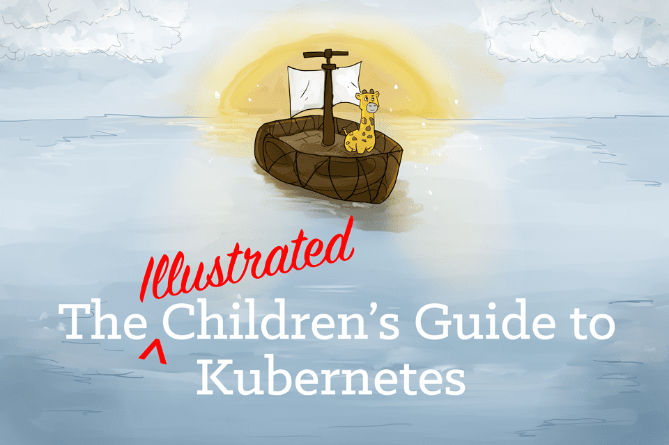




Kubernetes Basics
external network
cluster
Kubernetes
Node
Node
external IP address
Load Balancer Services
private IP address
private IP address
private IP address
Pod
Pod
Pod
Persistent Volume Claims
StorageClass
Persistent Volumes
disk storage

Slide 37
Other Kubernetes Objects
Namespace
Use this to scope your Kubernetes objects
Labels
Use this to “tag” your Kubernetes objects
Organize and query objects of the same label
Selectors to associate objects
Annotations
Assign a property to a Kubernetes object
Secret
Persisted storage for sensitive information like a password
NodePort
Non-cloud provider service for load balancing and exposing pods to external networks
ReplicaSet
Maintain set of the same pods at all times
StatefulSet
Maintain set of the same pods as unique instances at all times
DaemonSet
Deploy a specific pod on each node
Deployment
Declare state for pods including replicaset, update, rollback

Slide 38
How do you use Kubernetes?
Send a REST API request to the API Server
Not a programmer? Use kubectl and be a k8s programmer
Be a declarative programmer with YAML
Define storage, networking, and high-availability for SQL Server
Need a sa password? – Use a secret
Be smart with k8s
Use namespaces
Use labels
Use deployments

Slide 39

SQL Server – Basic Availability in Kubernetes
Built-in HA orchestration with no clustering required
Kubernetes
Node
Node
Node
Application
Load Balancer Service
Pod
Pod
SQL Server
SQL Server
Pod
SQL Server
ReplicaSet
Persistent Volume Claim

Slide 40
Module 07 Activity: SQL Server on Kubernetes

Slide 41
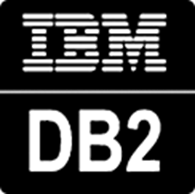







Module 08 Data Virtualization
HDFS

Slide 42

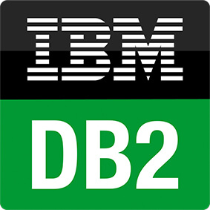




Remove data silos with Polybase
Challenge
Integrating data from numerous data silos is complex with traditional ETL methods
Solution
Access from multiple sources without moving data
Integrate data with data virtualization
T-SQL language with external tables
Distributed/scalable performance with Polybase
T-SQL
…
ODBC
NoSQL
Relational databases
Big Data
MongoDB
Azure SQL Database
Azure Cosmos DB
Excel
Intelligence over any data

Slide 43
What is SQL Server Polybase?
“It’s all about
Data Virtualization”
It all started with T-SQL against Hadoop
Query data where it lives using T-SQL
Compute engine integrated with SQL Server
Distributed, scalable query performance
Manual/deploy with SQL Server
Auto deploy/optimize with Big Data Clusters
Analytics
T-SQL
Apps
SQL Server
PolyBase external tables
ODBC
NoSQL
Relational databases
Big data
Excel
Cosmos DB
HDFS
Intelligence over all data

Slide 44
Using Polybase in SQL Server: T-SQL EXTERNAL TABLE
Login and password
Only for HDFS
Setup and configure Polybase
Setup authentication
Create EXTERNAL DATA SOURCE
Create EXTERNAL FILE FORMAT
Create EXTERNAL TABLE
Create statistics on key columns
Query like any other table
Not simple without BDC
And join to any other table or external table
metadata
WWI
Results streamed
HDFS
SQL
Data lives
here
INSERT only for HDFS
Cosmos DB

Slide 45
External Tables vs Linked Servers
External Tables
Database Scoped
ODBC Drivers
Linked Servers
Instance Scoped
OLEDB Providers
Read-only*
Single threaded queries with push-down
Scale out queries with push-down
Failover with AG
Requires separate config from AG
Basic authentication
Basic and integrated authentication
Distributed Transactions not supported
Distributed Transactions supported
Read/write
* Insert into HDFS allowed

Slide 46
The SQL Server Polybase Architecture
control and
execution
Data flow
EE only
All editions
All editions
“Head” node
“Compute” node
“Compute” node
DW dbs
SQL Engine
DW dbs
SQL Engine
DW dbs
SQL Engine
tempdb
tempdb
tempdb
Need more scale?
Add compute nodes
Polybase Engine
Polybase Engine
Polybase Engine
……...
Polybase Data Movement Service
Polybase Data Movement Service
Polybase Data Movement Service
Scan or pushdown
Scale out with partitions
shuffle
mpdwsvc.exe
Your data sources
Cosmos DB
HDFS

Slide 47
SQL Server 2019 serves as the hub for all your data
Legacy SQL Server
Azure SQL Database
Azure Cosmos DB
Legacy suppliers
Modern stock items
Mobile app orders
SQL Server 2019
Customers from acquisition
Accounts receivable
Order reviews
Intelligence over any data
Notes:
This is a great example for a company that has existing data sources but doesn’t want to or cannot move the data.

Slide 48
Module 07 Activity: Using Polybase with SQL Server 2019

Slide 49




Module 09 Big Data Clusters

Slide 50
Intelligence over all of your data
Data virtualization
Managed SQL Server, Spark, and Data Lake
Complete AI platform
Admin portal and management services
Integrated AD-based security
Analytics
T-SQL
Apps
REST API containers for models
SQL Server External Tables
SQL Server
Spark
SQL Server
ML Services
Spark & Spark ML
Compute pools and data pools
Scalable, shared storage (HDFS)
Open database connectivity
NoSQL
Relational databases
HDFS
External data sources
HDFS
Combine data from many sources without moving or replicating it
Scale out compute and caching to boost performance
Store high volume data in a data lake and access it easily using either SQL or Spark
Management services, admin portal, and integrated security make it all easy to manage
Easily feed integrated data from many sources to your model training
Ingest and prep data and then train, store, and operationalize your models all in one system
Notes:
BDC is all about providing the install and configuration of Polybase automatically but if you don’t have Hadoop we will install one for you and include Spark with it. The right side of the slide is about using BDC as a complete ML/AI platform. All of this deployed on a cluster that is secure and provides built-in management, HA, and scale using Kubernetes.
Breadcrumb here for Data Virt

Slide 51
Why SQL Server Big Data Clusters?
Deployed single solution
Deployed SQL Server with built-in Availability Groups and Active Directory Authentication
Use Data Virtualization through deployed Polybase Scale Out Groups
A deployed HDFS Cluster
Access HDFS with built-in Polybase connector through an optimized SQL Server Engine
A deployed Spark engine
A deployed built-in Data Mart for cached or offline results using a built-in Polybase connector
Access to Machine Learning with SparkML and SQL Server Machine Learning Services
Deploy applications such as Machine Learning Models and SSIS packages
Deployed set of services for control, management, and monitoring
Use the power of containers and Kubernetes for basic HA, storage, networking, and scale.

Slide 52










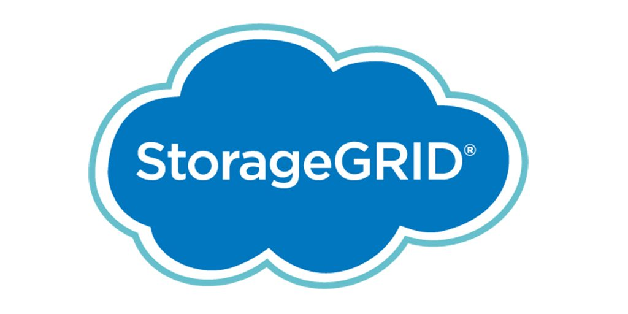


SQL Server 2019 Big Data Clusters
The combination of SQL Server, Polybase, HDFS, Spark, and Machine Learning in one solution
Custom apps
BI
Analytics
Controller
SQL Server master instance
Availability Group
Active Directory
Kubernetes
PolyBase
Scale performance with compute pool
Languages
App Deploy
Any external data source
SQL Compute Node
SQL Compute Node
…
SQL Compute Node
PolyBase
Data lakes with storage pool
SQL Server
SQL Server
…
SQL Server
Scale out data mart with Data pool
HDFS
HDFS
HDFS
HDFS
HDFS
HDFS
HDFS tiering
Balzano brings together diverse data on one shared platform to build and deploy and AI solution for clinical radiology
Intelligence over any data
Notes:
Whole quote:
"Building and deploying our vertical AI-solution for clinical radiology combines very diverse implementation paradigms, data formats and regulatory requirements. SQL Server 2019 big data clusters allowed us to accommodate and integrate all aspects from one shared platform - for our data scientists with their deep learning as well as for our software engineers who wire up workflows, security and scalability. At runtime, our healthcare customers benefit from simple containerized deployment and maintenance while being able to move our solution between on-prem and the cloud easily."
René Balzano, Founder and CEO, Balzano

Slide 53
Deploying a Big Data Cluster
Kubernetes choices
Azure Kubernetes Service (AKS)
Your Kubernetes Cluster (kubeadm)
Deployment Tools
azdata CLI to deploy
Customize with json
Azure Data Studio Wizard and Notebook deployment
Single deployment solutions
Python script for AKS
Bash script for kubeadm
Deployment Guidance
Minimum 8 CPUs, 64Gb RAM, 100Gb Disk, 24 disks
Offline supported

Slide 54







Using a Big Data Cluster through Endpoints
tds
sql-server-master
SQL Server Master Instance
gateway
Gateway to access HDFS files, Spark
webhdfs
HDFS File System Proxy
livy
Proxy for running Spark statements, jobs, applications
app-proxy
Application Proxy
sql-server-master-readonly
"/api/v1/bdc/endpoints
controller-svc
Port 443
controller – Cluster Management Service

Slide 55
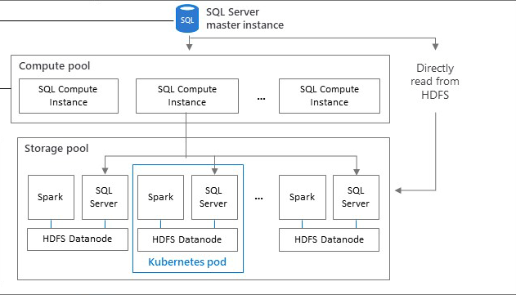
Using the Storage Pool
sqlhdfs connector
Compute Pool used if exists
HDFS name node deployed
YARN deployed
SQL Server engine in pool reads HDFS directory
webhdfs or livy endpoints
Zookeeper for HA
Mount external HDFS with Tiering
HDFS Tiering

Slide 56
Using the Data Pool
sqldatapool connector
INSERT, SELECT, TRUNCATE TABLE, EXECUTE AS
SQL Server instances with sharded data using columnstore
Ingest with T-SQL from any data source
Ingest with Spark from HDFS
Use for cached or offline results
Custom apps
BI
Analytics
Cluster
SQL
SQL Server master instance
Compute pool
SQL Compute Instance
SQL Compute Instance
…
SQL Compute Instance
Data pool
SQL Datapool Instance
SQL Datapool Instance

Slide 57
Spark and Machine Learning
Run Spark jobs through notebooks or livy endpoint
Ingest data with Spark into HDFS or external tables
Build machine learning models with SparkML or SQL Server Machine Learning
Connect to SQL Server using the MSSQL Spark Connector
Deploy a Spark pool to enable more compute
Deploy a Machine Learning model with Application Deploy

Slide 58

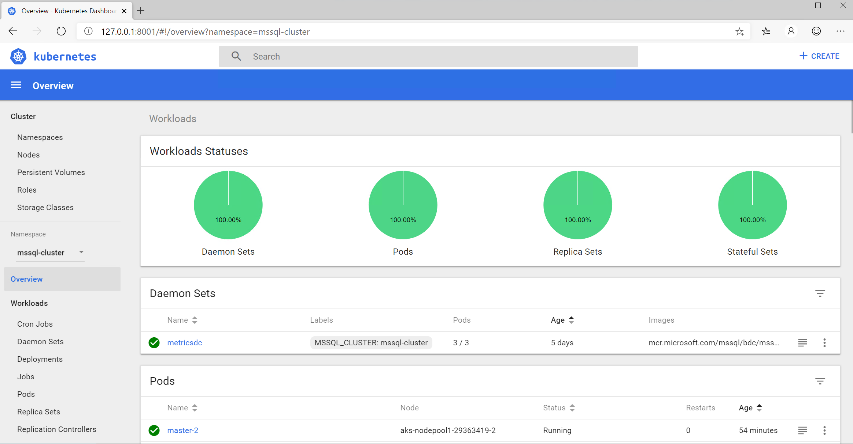
Managing and Monitoring Big Data Clusters
Management Endpoints
controller – Cluster Management Service
metricsui -Metrics with Grafana
logsui - Logging with Kibana
spark-history - Spark Job History
yarn-ui – Spark Job Diagnostics
azdata is the “kubectl” of Big Data Clusters
Dashboards with Azure Data Studio
Troubleshooting Guides with Notebooks
Use kubectl
Copy files into containers like Database Backups
Dive into logs like SQL ERRORLOG files
Dive into Kubernetes events and pod details
Kubernetes Dashboard

Slide 59
Module 09 Activity: Using and Managing Big Data Clusters

Slide 60
Module 10 Additional Capabilities, Migration, and Next Steps

Slide 61
Voice of the customer
User experience
#1 voted customer feedback item: String Truncation
MAXDOP and Memory Config during Setup
Memory Grant Percent in Resource Governor
Estimate compression for Columnstore indexes
Diagnostics
Troubleshoot page waits with new built-in T-SQL
Diagnostics for auto stats blocking
Custom capture policy for the Query Store
Columnstore stats in DBCC CLONEDATABASE
Performance
Reduce recompiles for tempdb workloads
Indirect Checkpoint Scalability
Concurrent PFS updates
Worker stealing
Inline log writing
String or binary data would be truncated
String or binary data would be truncated
in table '%.*ls', column '%.*ls’.
Truncated value: '%.*ls'
SELECT page_info.*
FROM sys.dm_exec_requests AS d
CROSS APPLY sys.fn_PageResCracker(d.page_resource) AS r
CROSS APPLY sys.dm_db_page_info(r.db_id, r.file_id, r.page_id,'DETAILED’)
AS page_info;

Slide 62



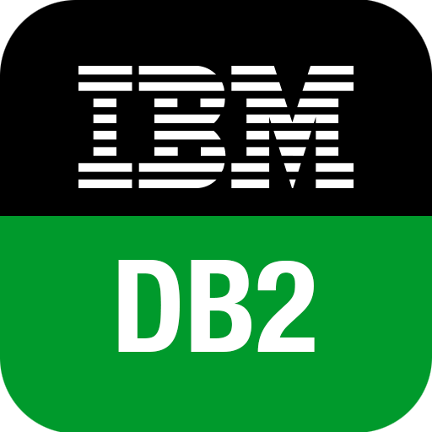

Migrate to the modern SQL Server
Migration from legacy SQL Server
Migration from external databases
Database Experimentation
Assistant
Legacy SQL Server
SQL Server 2019
SQL Server in Azure Virtual Machine
SQL Server
In-Place (Windows)
Database Backup
Log Shipping
Bulk Import
SSIS
Microsoft Access
Data Migration Assistant
Azure Database Migration Service
SQL Server Migration Assistant (SSMA)
Query Tuning Assistant

Slide 63
Certify once with Compatibility Certification
Upgrade & modernize your SQL Server database on-premises, in the cloud and on the edge with Compatibility Certification that eliminates risks of application compatibility
Upgrade to the latest SQL Server Database Engine without changing your critical applications
Compatibility Certification benefits
Unified application certification
Applications tested and certified on a given SQL Server version are also implicitly tested and certified on that SQL Server version native database compatibility level
Reduce upgrade risks
Separate application and platform layer upgrade cycles for less disruption
Microsoft fully supports Compatibility Certification
Frictionless migration with no code changes
Upgrade to latest SQL Database Engine version
Upgrade your SQL Server Database Engine or move instances to the cloud with no code changes
Notes:
Starting with SQL Server 2016, the SQL Server team has stopped deprecating compatibility levels purposefully. The Database Engine is also literally the same accross SQL Server and Azure SQL (including Managed Instance), so a database can be moved seamlessly and the same database code (T-SQL) works the same and undergoes the same optimization processes.​
Therefore, an application that was certified for compatibility 100 (SQL 2008) can work with the same behavior that was set for that version, even when moved to Azure SQL or a modern version of SQL Server.​
This means:​
•No more need to specifically certify for Azure or on-premises separately. Applications tested and certified on a given SQL Server version are also implicitly tested and certified on that SQL Server version native database compatibility level.​
•Reduced upgrade risks because during platform modernization, application and platform layer upgrade cycles can be separated for less disruption, and improved change management​
•Upgrading to a new version of SQL Server or Azure SQL can be done with no code changes by keeping the same compatibility level as the source​
New Databases are set to compatibility level mapping to the version of the Database Engine. When a database is upgraded from any earlier version of SQL Server, the database retains its existing compatibility level if it is at least minimum allowed for that instance of SQL Server or Azure SQL. Upgrading a database with a compatibility level lower than the allowed level (for example from SQL 2005), sets the database to the lowest compatibility level allowed.

Slide 64
SQL Server 2019 Editions
Build once and deploy across any SQL Server edition without changing your app
Enterprise
Mission-critical performance and intelligence for tier 1 databases
Standard
Full featured database with Big Data Clusters for mid-tier applications and data marts
Feature highlights
Unlimited cores of CPU
Unlimited memory
Industry-leading performance with unmatched scalability
Unlimited virtualization benefits
Petabyte scale data warehousing
Business critical HA on Windows and Linux
Access to Power BI Report Server
Express/web
Free, entry-level database for small web and mobile apps
Feature highlights
Up to 24 cores of CPU
Up to 128 GBs of memory
SQL Server 2019 Big Data Clusters ^{NEW}
Data virtualization through PolyBase ^{NEW}
Accelerated Database Recovery ^{NEW}
Transparent Data Encryption ^{NEW}
Enhanced in-memory performance
Automatic intelligent database tuning
Feature highlights
Up to 16 cores of CPU
Up to 64 GBs of memory
Encryption with secure enclaves ^{NEW}
UTF-8 character encoding ^{NEW}
Data classification and auditing ^{NEW}
In-memory OLTP and Columnstore
Full T-SQL surface area
Support for Linux containers
+ Standard features
+ Express/web features
+ Express/web features
Developer
Free to use with all the features of Enterprise Edition specifically for dev/test in non-production environments

Slide 65
Get started with SQL Server 2019
Download and try it: http://aka.ms/ss19
Use our free training: https://aka.ms/sqlworkshops
Use examples through our https://aka.ms/SQL2019Notebooks
Learn from videos: https://aka.ms/sql2019learning
Read what’s new for SQL 2019: documentation
Watch how to Modernize SQL Server: check out the video
Get the book: https://aka.ms/sql2019book

Slide 66

Wrap-up and Q&A

